Slide 1
Bellabeat Case Study: Smart Device Usage Analysis
Prepared by Okello Cecilia, Junior Data Analyst

Slide 2
Title & Introduction
Bellabeat Case Study
Objective: To analyze smart device usage data and provide actionable recommendations for Bellabeat's marketing strategy.

Slide 3
Business Task & Stakeholders
Business Task: Analyze non-Bellabeat smart device data to uncover trends and apply insights to improve Bellabeat products. Stakeholders:
Urška Sršen (Cofounder & Chief Creative Officer)
Sando Mur (Cofounder & Mathematician)
Bellabeat Marketing Analytics Team
Bellabeat Executive Team

Slide 4
Data Collection & Cleaning Summary
Data Source: Fitbit Fitness Tracker Data (30 users) Data Fields: Daily activity, steps, calories burned, sleep patterns, heart rate. Cleaning Steps:
Removed duplicates and missing values.
Converted date columns to appropriate formats.
Handled outliers in step count and sleep data.

Slide 5
Key Trends & Analysis Summary
Key Trends:
Higher activity correlates with higher calorie burn.
Consistent sleep patterns contribute to better health.
Users engaged in regular physical activity show improved wellness metrics.

Slide 6
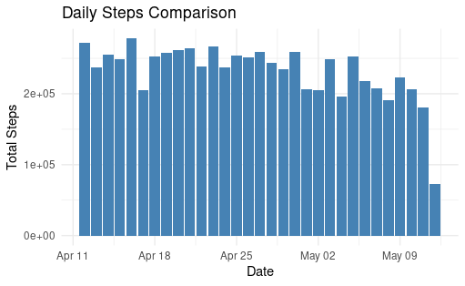
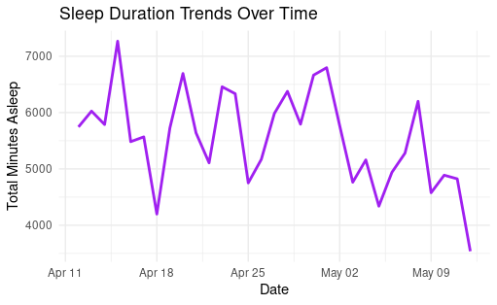
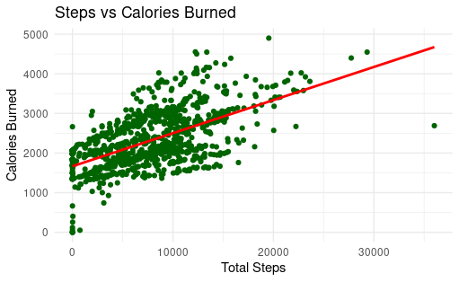
Key Data Insights and Visualizations

Slide 7
Insights & Recommendations
Insights:
Physical activity leads to better calorie management.
Sleep consistency improves overall well-being.
Recommendations:
Enhance the Bellabeat app to reward consistent tracking.
Promote Bellabeat products emphasizing activity and sleep tracking.

Slide 8
Next Steps & Conclusion
Next Steps:
Implement new app features based on findings.
Launch marketing campaigns focused on wellness tracking.
Continue analyzing new datasets for further insights.

Slide 9
THANK YOU!
www.linkedin.com/in/cecilia-okello-15173423a

